Slide 1
What would you most relate in modern society to myths, legends and folktales as a form of story telling?

Slide 2
Super Hero
A superhero is a type of character possessing "extraordinary or superhuman powers" and dedicated to protecting the public. Although they might not always have superhuman powers (Batman)

Slide 3
Character(s)
A character is a fictional representation of a person. Usually, but not always, it’s a psychologically realistic depiction.
Characters are “developed” in two ways:
1. We can be told about them by the narrator who gives us info about what the characters are doing or thinking, what they look like, how they’re dressed, what values they hold, etc. Sometimes the narrator will make a judgment about a character’s behavior or provide an analysis of it.
2. The character’s personality traits and/or motivation(s) may be revealed through actions, dialogue, or thoughts.

Slide 4
Character(s)—Round or Flat
In his 1927 work, Aspects of the Novel, author E.M. Forster coined the terms “round” and “flat” to describe character development in a literary work.
A “round” character is well-developed in the story and is closely involved in and is responsive to the action in the story. This is a character that the reader can clearly identify as a main character.
A “flat” character is one that is barely developed or is stereotypical. It’s harder for the reader to get involved with this character or to care what happens to him/her in the course of the story. An example might be the stereotypical “drunk” in a Wild West story.

Slide 5
Character(s)—Dynamic or Static
Characters can be classified as either “dynamic” or “static.”
A dynamic character grows and changes in a significant way throughout the course of the story as he/she reacts to events and other characters. The dynamic character may grow and change in relation to self-awareness, to maturity, to the human condition, or to a number of factors. Dynamic characters sometimes experience epiphanies.
A static character, on the other hand, may face the exact same challenges as the dynamic character, but will remain unchanged by events or other characters. If the static character is selfish and arrogant at the beginning of the story, he/she will be the same way at the end of the story.

Slide 6
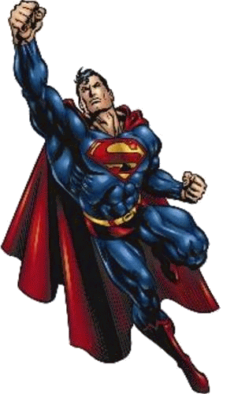
Superman
The history of Superman is more than just that, it is the history of the entire genre of superheroes.
Superman was the first true superhero and it was his enormous popularity that led to the mass movement of superheroes in comic books and in other pop culture and entertainment.
The term superhero actually stems from the name Superman.

Slide 7
Exposition (Origin)
Scientist Jor-L discovers that Krypton is about to explode, yet he cannot convince his fellow Kryptonians to save themselves.
He manages to construct a spaceship to save his infant son, Kal-L.
The ship launches just as the planet explodes, with Kal-L landing on Earth in a farm country town (later identified as Smallville) around the time of World War I.
In this version, John and Mary Kent (passing motorists who witness the spaceship landing) take the infant naming him Clark.

Slide 8
Origin
Clark grows up on the Kent family farm, slowly discovering that he possesses various superpowers but unaware of his Kryptonian origins.
Clark decides to use his powers for the benefit of humanity, constructing a stylized costume and moving to the nearby city of Metropolis.
Clark begins work as a reporter at the Daily Star newspaper and soon makes his debut as the world's first superhero, Superman.

Slide 9
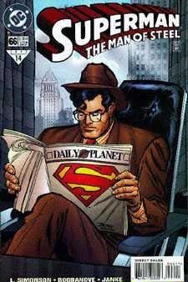
Alter Ego
Superman lives among humans as a "mild-mannered reporter" for the Metropolis newspaper Daily Planet.
There he works alongside reporter Lois Lane, with whom he is romantically linked.

Slide 10
Super Hero Project Exposition of the Protagonist
Describe their childhood, parents, family?
Give a physical description of the hero as a child.
Tell the story relating to how he/she got any distinguishing physical characteristics, explains how he/she got his/her special powers.
What made them become a Superhero? (Necessity or want)
What is their everyday life like when they are not being a super hero?

Slide 11
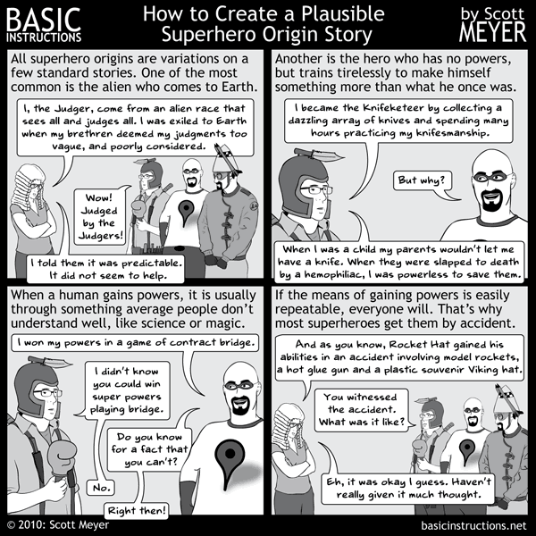

Slide 12
Setting
This is the time and the place in the story, the details of which are important to our understanding of the entire meaning of the story.
Look at these contexts when reading:
Historical context
Geographical context
Physical context

Slide 13
Setting
Historical context: This lets the reader know what the social, political, economic, and cultural environment was surrounding the story
Geographical context: Knowing the location may help explain the behavior of the characters. The size of the location and the “lay of the land” can provide the reader with clues about the story’s theme or can act as foreshadowing.
Physical context: Observe elements like the weather, the time of day, and whether or not the story’s setting is indoors or outdoors. The outdoors may suggest expansive freedom; the indoors may suggest isolation or limitations. Outdoor settings may free a character from the social norms of behavior for a time. Ex.– A Midsummer Night’s Dream. Storms may foreshadow imminent danger or other threats. Weather may test the character’s actions when they have to struggle against the environment.

Slide 14
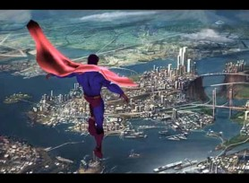
Setting: Metropolis
Home of Superman and known as the City of Tomorrow by its residents
Sprawling city
Metropolis is portrayed as one of the largest and wealthiest cities on earth.
The co-creator and original artist of Superman, Joe Shuster, modeled the Metropolis skyline after Toronto, where he was born and lived until he was ten.
Metropolis has become a city inspired by Chicago, Cleveland, Detroit, Toronto, Vancouver, New York City and Los Angeles.

Slide 15
Super Hero Project Setting
What is geographical context? Where does he/she live? (City, State, Country) This can be fictional, real, or a mixture of both.
What is the historical context? What time frame? (Present, Future, Past) Describe in detail. What is the state of society? (Peaceful, War, Crime Riddled)
Describe his/her hideout, headquarters, or lair.

Slide 16
Protagonist/Antagonist
The protagonist is the main character throughout the novel. A novel can have more than one protagonist (e.g. two or even three main characters).
The force with which the protagonist is in conflict is called the antagonist.
The force can be a person or persons, society or an internal struggle within the main character.

Slide 17
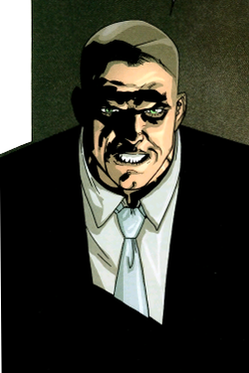
Antagonist- Lex Luthor
He is the archenemy of Superman, although given his high status as a super villain.
Luthor is described as "a power-mad, evil scientist" of high intelligence and incredible technological prowess.
His goals typically center on killing Superman, usually as a stepping stone to world domination.
Lex has no super powers other than his intelligence and no alternate identity
Although a round character, he is static

Slide 18
Super Hero Project Antagonist:
Who is the villain or arch enemy of the super hero?
Describe their back story. Where did he/she come from? How did they become evil? What is his/her goal?
Describe his/her costume, logo, style.
Does the villain have super powers? If so, what are they?

Slide 19
A supporting character
is a character of a book, play, video game, movie, television or other form of storytelling usually used to give added dimension to a mail character, by adding a relationship with this character. Sometimes supporting characters may develop a complexity of their own, but this is usually in relation to the main character, rather than entirely independently.
In some cases, especially in ongoing material such as comic books and television series, supporting characters themselves may become main characters in a spin-off if they are sufficiently popular with fans.

Slide 20
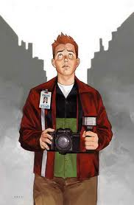
Superman’s Sidekick: Jimmy Olsen
Jimmy is traditionally depicted as a bow tie-wearing, red-haired young man who works as a cub reporter and photographer for The Daily Planet, alongside Lois Lane and Clark Kent, whom he idolizes as career role models. He also has a strong friendship with Superman.
Jimmy has special access thanks to Superman's gift to Jimmy of a "signal watch," a wristwatch which, with the press of a button, emits a special ultrasonic frequency signal that Superman can hear anywhere on Earth.

Slide 21
Supporting Characters
Sidekick or Support Staff (helpers) Who are they?
Back Story and History
Where did they come from?
How did they start helping the hero?
Do they have any superpowers? Skills? What makes them an asset to the hero?
Love Interest
Where did they come from?
How did they meet?
What makes their relationship difficult?

